Slide 1
Data Mining – Airbnb in New York City
Bijiao Shen

Slide 2
Why Airbnb?
Airbnb is a relatively young company that is disrupting the housing market
One of the pioneers of the “gig economy”
Currently dealing with growing pains

Slide 3
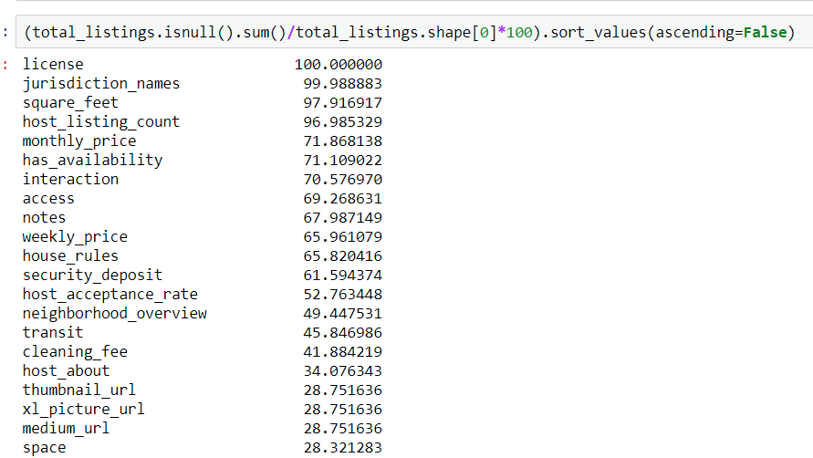
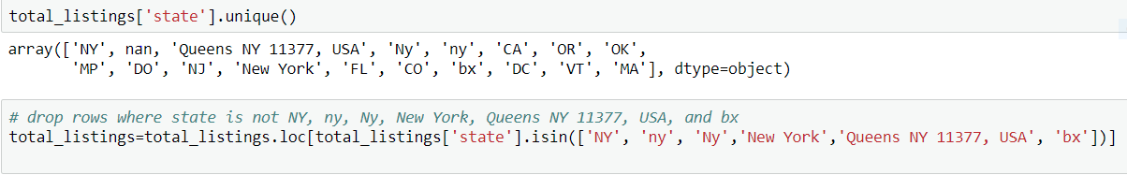
Data Source and Issues
Data Source: http://insideairbnb.com
Time Period: 2015-01 to 2017-05
Issues:
Missing data
Errors

Slide 4
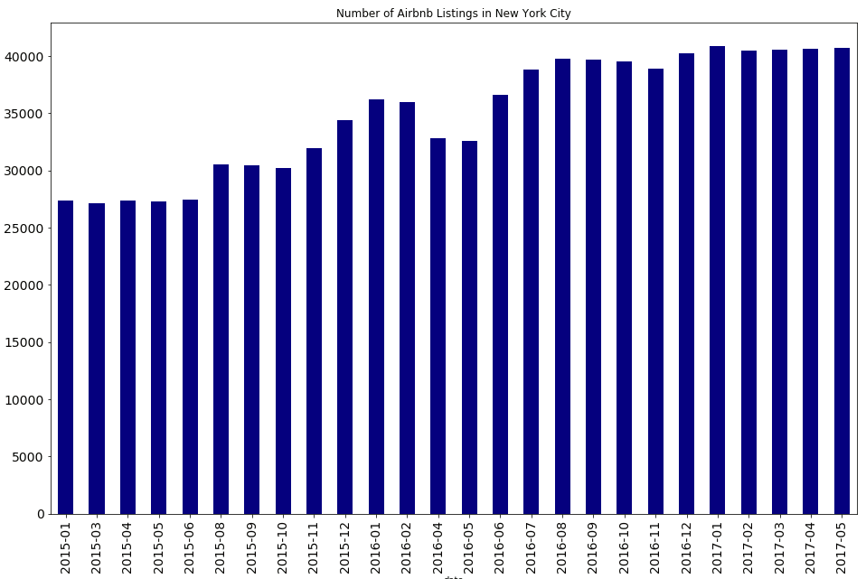
Airbnb has experienced solid growth in the past two years in listings

Slide 5
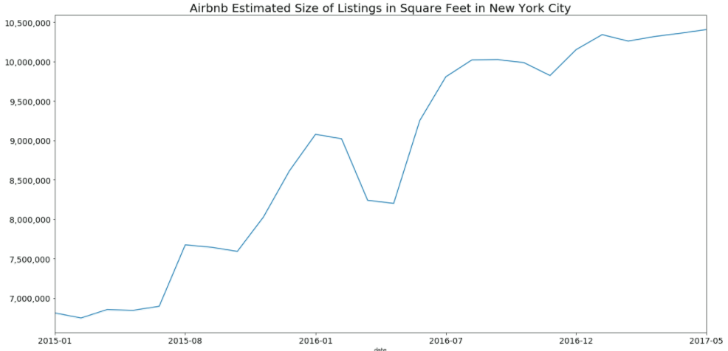

..and total square footage

Slide 6
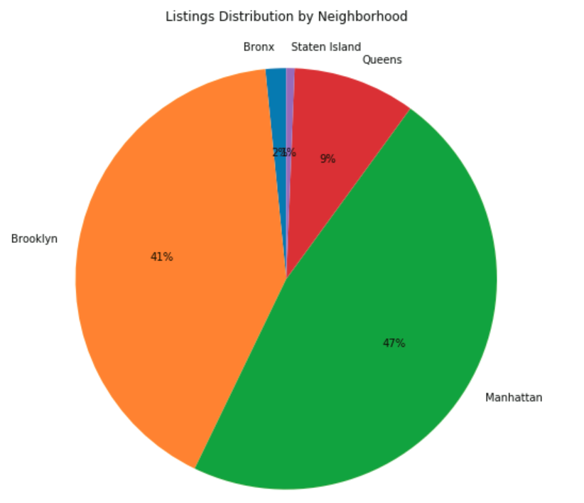
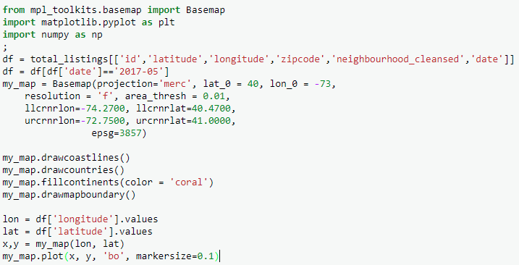
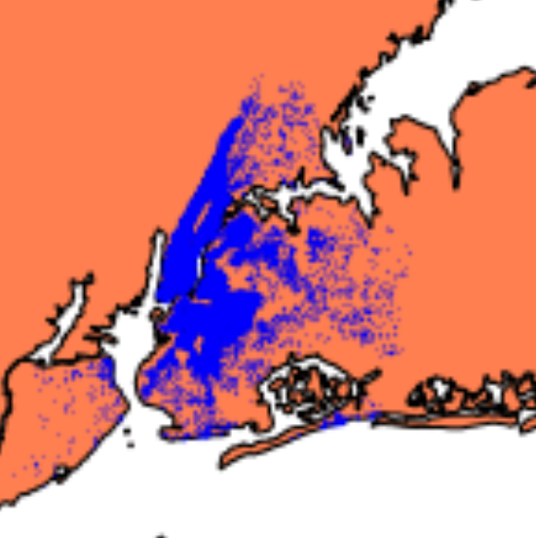
Listings are concentrated in two boroughs

Slide 7
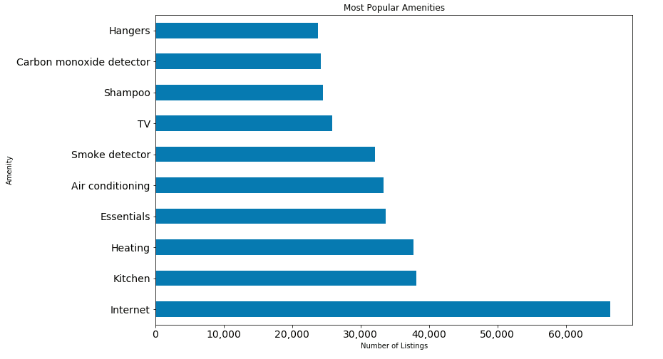

Internet tops popular amenities list

Slide 8
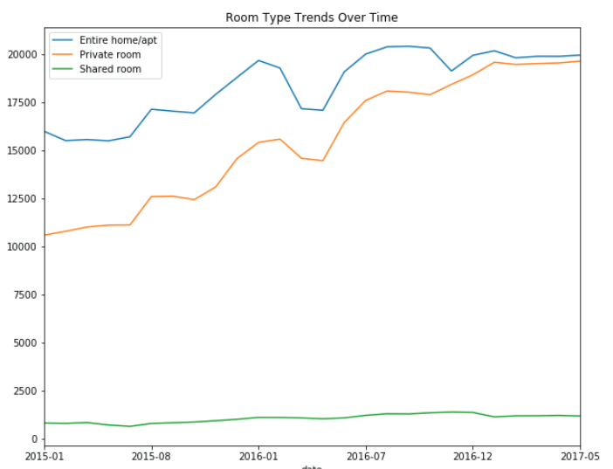
Preferences growing for space and privacy
Shared rooms have stagnated
Private options have grown in popularity

Slide 9
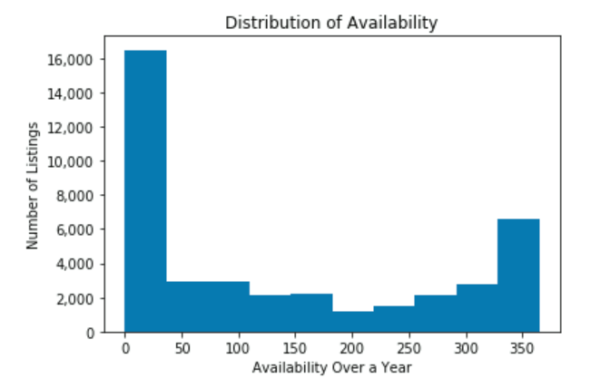
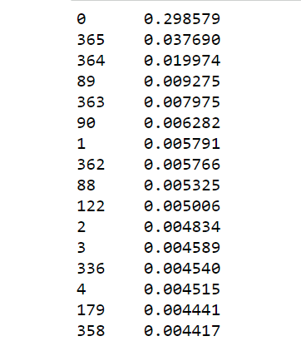
Availability varies greatly
Availability in a year / Percentage

Slide 10
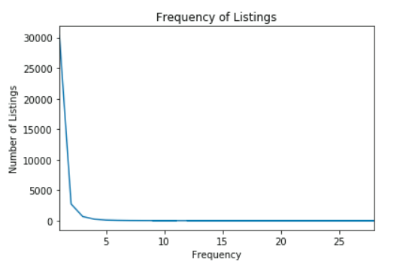
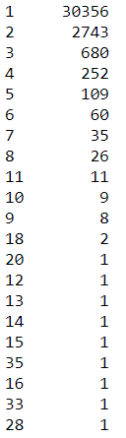
Most hosts are casual listers
Almost three quarters of hosts list only one property
# of listing / count of hosts

Slide 11
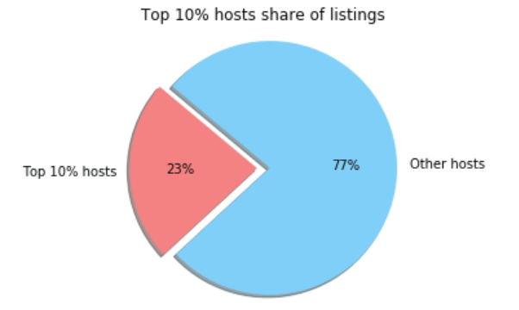
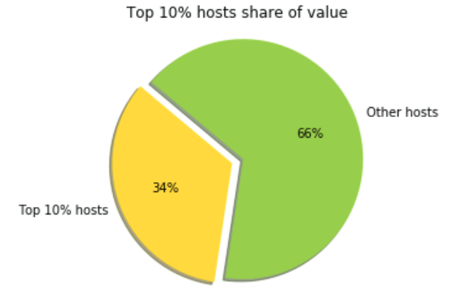
“Power Hosts” dominate the market

